Slide 1
Weekly report 26th March 2018
Huy-Hung Ho
Key Laboratory for Smart Integrated Systems (SISLAB),
VNU University of Engineering and Technology (VNU-UET)

Slide 2
Completed work
Find thesis of ANN and writing thesis
Introduction part
Run open-source ANN in Artix-7

Slide 3
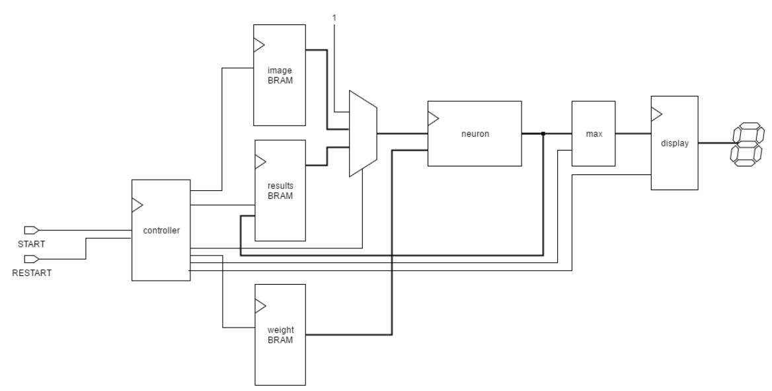
Open-source architecture
Fully sequential architecture
Only 1 neuron

Slide 4
Proposed neuron module
Requirement architecture
Parallel -> SC
Able to apply for FPGA -> cannot fully parallel
Follow open-source archtecture
Modify neural module
Modify SRAM module
Modify controller

Slide 5
Proposed neuron module
bias
Activation function
Multiplier &
Binary Tree Adder
Weighted input
16
Input
Output
+
+
16 Weight
Sum
temp

Slide 6
Next week
Writing thesis
Outline
Design proposed neuron module use VHDL

Slide 7
THANKS FOR YOUR ATTENTION

